Slide 1

YOUR dental plan options
Teachers Association of Lindenhurst
Plan year: 2017
Offered by Cigna Health and Life Insurance Company, Connecticut General Life Insurance Company, or their affiliates.
862420 b

Slide 2

Together, all the way.
You go the extra mile to be healthy, but you don't have to go it alone.
We'll be right by your side with the coverage, tools and resources to help you – in sickness and in health.
Together, we can help you live a healthier and more secure life.

Slide 3
A dental plan that gives you choice
You can choose to use any licensed dentist, but see bigger savings if you use a dentist in the Cigna dental network
You can see a specialist without a referral
Once you receive services, you’ll pay a portion of your covered dental care costs – coinsurance – and the plan pays the rest
Most Total Cigna DPPO dentists will submit claims for you. Your plan will then pay the dentist or you (based on the claim form)
The amount your plan pays depends on:
  The coinsurance level for the service you received
  Which dentist you visit
Once you reach the plan’s annual benefit maximum, your plan will no longer pay a portion of your costs during that plan year
Cigna Dental Preferred Provider Organization (DPPO)
Notes:
The Cigna DPPO plan offers a healthy balance of savings and choice. You and your covered family members have convenient access to quality dental care through our nationwide network of dentists — dentists who have agreed to offer their services to our members at reduced contracted fees. Or, you have the option to visit any licensed dentist or up to the dentists’ usual (full) fee with out-of-network dentists
. You also have the freedom to choose any specialist without a referral.
Whether you choose a dentist in the Cigna Network or outside the network, your coverage includes a wide range of eligible services after you satisfy any waiting period and meet your deductible. Your plan will pay part of your costs (shown by the coinsurance amount on your Benefit Summary) until your plan’s maximum is reached.
With the Cigna DPPO, you do NOT need to choose a primary network dentist at enrollment. Instead, you can choose a dentist when you’re ready to make an appointment. You can even choose a different dentist each time. But here’s the most important thing to remember … If you choose a Network dentist, you can spend less out-of-pocket!
You do not need an ID card to receive care. But you can print one from myCigna.com.
Most Network dentists will submit claims for you, and your plan will pay the dentist directly. If instead, you pay the full amount to the dentist’s office, you can submit a claim and ask to be reimbursed directly. Find claim forms online at myCigna.com.
With the DPPO plan, you do not need a referral to visit a dental specialist. But again, you’ll save if you visit a dental specialist in the Cigna Dental Network!
_______________________________________________________________
Bring sample pre-enrollment kit (ordered through KitTrak). Materials should be specific to customer if possible.
Toll-free number: 1.800.Cigna24

Slide 4
Your coverage
Total Cigna DPPO
DENTAL:
DPPO
 | In-Network Contracted Rate | Out-of-network* MRC
Class I – Preventive care | 85% | 85%
Class II – Basic restorative** | 85% | 85%
Class III – Major restorative** | 50% | 50%
Class IV – Orthodontia** | 50% | 50%
Class V- TMJ | 80% | 80%
Class IX - Implants | 50% | 50%
Annual deductible | None
Calendar-year maximum | $2000
Lifetime Maximum: Orthodontia | $4000
Annual benefit Maximum | $3000
s.
Notes:
Here’s a high-level overview of what your plan pays for your care. Refer to your Benefit Summary for details.

Slide 5
Thousands of dentists, one directory
DENTAL:
DPPO
With the Total Cigna DPPO network, you have a choice of thousands of dentists nationwide.¹
We have more than
136,000² total unique dentists in the
Total Cigna DPPO Network’s nearly 380,000³ office locations.
All participating dentists are consolidated into
one directory, which you can easily search online at Cigna.com and myCigna.com.
NetMinder. DPPO data as of September 2014, reflecting Total Cigna DPPO counts of unique dentists. Data is subject to change. The Ignition Group makes no warranty regarding the performance of the data and the results that will be obtained by using.
Cigna internal network analysis. Actual total unique dentists as of March, 2015 is 136,038. Data is subject to change.
Cigna internal network analysis. Actual total office locations as of March, 2015 is 379,488. Data is subject to change.

Slide 6
A plan where one dentist coordinates your care within a network that provides general and specialty dental care
.
You choose a primary care dentist in the DHMO network where you can receive all your care
By using dentists in the DHMO network you may pay less than you would with other types of dental plans
You pay the charge listed on your Patient Charge Schedule
There is no out-of-network coverage (except in emergencies)**
There are no deductibles and no annual dollar maximums
Cigna Dental Care® Dental Health Maintenance Organization (DHMO*)
*The term “DHMO” is used to refer to product designs that may differ by state of residence of enrollee, including, but not limited to, prepaid plans, managed care plans, and plans with open access features.
**There are no out-of-network benefits with a DHMO plan except in the case of emergencies. For residents of MN and OK coverage is available out-of-network. See Appendix A for details
Notes:
The DHMO plan allows you to maximize your savings. First, you will typically pay less for the DHMO than for other dental plan options.
Second, there are no deductibles. Deductibles are amounts that individuals sometimes have to pay before their plans begin paying for a portion of their dental care costs. With the DHMO, there is no up-front expense before your coverage begins.
Third, there are no annual dollar maximums. Annual Dollar Maximums are dollar limits to what a plan will pay for your dental care in a specified period of time such as a plan year, or for your lifetime. The DHMO doesn't have any annual dollar maximums; Any frequency limitations under your plan are outlined in your Patient Charge Schedule.
And fourth, your out-of-pocket costs for covered procedures are listed on your Patient Charge Schedule – regardless of which Cigna DHMO network dentist you visit. Making it easier for you to budget for your dental expenses.

Slide 7
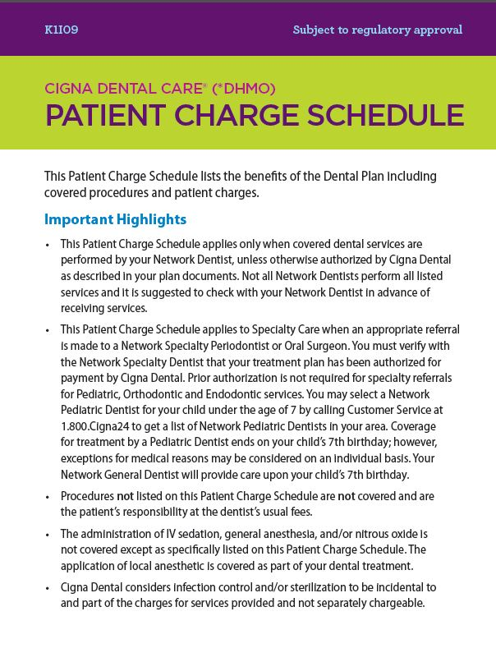

Slide 8

DHMO
Coverage with no deductibles or waiting periods
DENTAL:
DHMO
Examples of covered services*
Preventive care, such as cleanings and exams, at no added or low cost
Additional cleanings, fluoride, and fluoride varnish available for a copay
Temporomandibular joint (TMJ) diagnosis
General anesthesia/IV sedation when medically necessary
Coverage for brush biopsy, a noninvasive diagnostic procedure for detecting oral cancer
Coverage for teeth whitening (take-home bleaching gel with trays) and athletic mouth guards
No age limit on sealants
Coverage for advanced procedures like crowns and bridges over implants
Second opinions covered
Emergency care
Orthodontic coverage for children AND adults
* Plan copayment and coinsurance requirements apply. Prior authorization may be required for certain specialty care treatments. Not all services are covered. See Appendix B for a listing of related plan limitations and exclusions.
Notes:
NOTE TO PRESENTER: Some features are not available on all Patient Charge Schedules. Check the PCS and edit the slide as needed. 24/7 dental information line & Coverage for Advanced procedures like crowns & bridges over implants DO NOT apply 07’s or earlier schedules.
Everything you see here is included with your DHMO plan: Preventive Care, such as cleanings and exams; sealants; restorative care (such as fillings); and specialty care such as Orthodontia. View your PCS for any limitations and exclusions.
Each member of your family can choose their own network dentist. This is important when, for example, your child is away at school or your spouse needs to find a dentist near work.
Second opinions are covered. Just call Customer Service and they’ll help you make the arrangements.
If you’re in pain and need immediate care, call Customer Service for the name of a nearby network dentist. If an emergency occurs after business hours or a network dentist isn’t available, or you are out of the area, you can use any dentist. Cigna Dental will reimburse up to [$50] of your costs, less applicable patient charges. Or, according to the group agreement/member booklet, e.g., Texas and Pennsylvania have no $ limit.
General Anesthesia/IV sedation is covered when medically necessary and performed by a participating oral surgeon or periodontist.

Slide 9

HELP WITH YOUR ORAL HEALTH
Programs and services

Slide 10
Cigna Dental Oral Health Integration Program®
PROGRAMS
& SERVICES
More programs
More wellness
More discounts
Available to ALL Cigna Dental customers with qualifying condition(s)
Articles on behavioral issues linked to oral health
40% off* average retail prices on certain prescription dental products*
Dental Services | Heart Disease | Stroke | Diabetes | Maternity | Chronic Kidney Disease | Organ Transplants | Head and neck cancer radiation
Periodontal treatment and maintenance (D4341, D4342, D4910¹) | u | u | u | u | u | u | u
Periodontal evaluation (D0180) |  |  |  | u
Oral evaluation (D0120², D0140², D0150²) |  |  |  | u
Cleaning (D1110³) |  |  |  | u
Emergency palliative treatment (D9110⁴) |  |  |  | u
Topical application of fluoride and topical application of fluoride varnish (D1206⁵) |  |  |  |  | u | u | u
Topical application of fluoride – excluding varnish (D1208⁵) |  |  |  |  | u | u | u
Sealants (D1351⁵) |  |  |  |  | u | u | u
Sealant repair – per tooth (D1353⁵) |  |  |  |  | u | u | u
1. Four times per year.
2. One additional evaluation.
3. One additional cleaning
4. No limitations.
5. Age limits removed, all other limitations apply.
For DPPO plans, reimbursement under this program is subject to and applied to any applicable plan year benefit maximums.
* Pharmacy discounts are available through Cigna Home Delivery Pharmacy only. This is a discount and is NOT insurance. This discount is separate from your dental benefits and you are required to pay the entire discounted charge. Discount based on Cigna Pricing Analysis of National Average Wholesale Price and Customer Costs, June, 2014. Actual discount will vary by product and location.
Notes:
10
The Oral Health Integration Program is available to ALL Cigna Dental customers, regardless of their medical carrier. Customers must have one of the specific medical conditions to qualify for reimbursement.
Behavioral Issues Affecting Oral Health: Customers submitting a Registration Form for a procedure covered under OHIP can get articles on Tobacco Cessation, Fear of Going to the Dentist and Stress and the Impact on Oral Health.
Discounts: Customers submitting a Reimbursement Form for a procedure covered under OHIP will be eligible for discounts of 40% off average retail prices on certain prescription dental products through Cigna Home Delivery Pharmacy. They’re also eligible for free samples and discounted non-prescription dental products developed for patients with a higher risk for periodontal disease and cavities.
Covered dental procedures by medical condition:
Cardiovascular, Cerebrovascular (Stroke), Diabetes:
D4341- periodontal scaling and root planning -four or more teeth per quadrant
D4342- periodontal scaling and root planning –one to three teeth per quadrant
D4910- periodontal maintenance
Maternity :
D0120- periodic oral evaluation – established patient
D0140- limited oral evaluation – problem focused
D0150- comprehensive oral evaluation – new or established patient
D0180- periodontal evaluation – new or established patient
D1110- prophylaxis - adult (cleaning)
D4341- periodontal scaling and root planning -four or more teeth per quadrant
D4342- periodontal scaling and root planning –one to three teeth per quadrant
D4910- periodontal maintenance
D9110 -palliative (emergency) treatment – minor procedure
Chronic Kidney Disease, Organ Transplant and Head and Neck Cancer Radiation:
D1203 – topical application of fluoride – child
D1204 – topical application of fluoride – adult
D1206 – topical fluoride varnish; therapeutic application for moderate to high caries risk patients
D1351 – sealant – per tooth
D4341 - periodontal scaling and root planning -four or more teeth per quadrant
D4342 - periodontal scaling and root planning –one to three teeth per quadrant
D4910- periodontal maintenance

Slide 11
More than just dental benefits
PROGRAMS
& SERVICES
Cigna
Healthy Rewards®*
Identity Theft Resolution Services**
Dental Information Line
Cigna Healthy Rewards®
Discounts on a full range of health and wellness programs and services
For DHMO customers, help with critical issues like credit card fraud, or financial and/or medical identity theft
24/7 access to trained professionals who can help answer your questions about dental treatment and clinical symptoms
*Healthy Rewards is a discount program and is separate from your dental benefits. If your plan includes coverage for any of the services offered through Healthy Rewards, this program is in addition to, not instead of, your plan benefits. Some Healthy Rewards programs are not available in all states and may be discontinued at any time. A discount program is NOT insurance, and you must pay the entire discounted charge.
** Cigna’s identity theft services are provided under a contract with Europ Assistance USA. Full terms are contained in Cigna’s Identity Theft Program service agreement. This program is NOT insurance and does not provide reimbursement for financial losses.
Notes:
NOTE TO SALES: Remove all references to Healthy Rewards if using presentation in MD or OH.
Through Cigna Healthy Rewards, Cigna Dental members have access to discounts on a full range of health and wellness programs and services often not covered by traditional insurance plans.
 Times may be tough, but they don’t have to take a toll on your teeth and gums. Remember, the key to a healthy smile is to take care of your teeth and gums before problems begin.
[For DHMO 07, 08, 09, P, Q, A and C Series PCS clients only] Your Cigna dental plan covers most preventive services at no or low cost to you and helps you have a healthy smile.
If you have good oral health, your dentist may recommend a cleaning once or twice a year. The dentist or hygienist will remove plaque, tartar, and stains from your teeth.
[For DHMO 07, 08, 09, P, Q, A and C Series PCS clients only] If your dentist recommends more frequent cleanings we’ve got you covered there too. You can have up to four cleanings a year, with two at no charge, and two more with a minimal copay/coinsurance.
If you show signs of gum disease, your dentist may recommend periodontal scaling and root planning or a “deep cleaning.” If you’ve had prior treatment such as deep cleaning for gum disease, your plan covers periodontal maintenance services beyond the first 12 months following active treatment (limitations may apply).
 You can test your risk for gum disease, cavities and oral cancer! Just go to www.cigna.com and type “gum disease risk”, “cavity risk” or “oral cancer risk” in the search box.
Tooth decay is another form of dental disease. In fact, it’s one of the most common chronic infectious diseases among U.S. children. (Centers for Disease Control and Prevention, July, 10 2013, Preventing Dental Caries With Community Programs.) Fluoride treatments can help prevent tooth decay in children, so your plan covers two fluoride treatments each year (including fluoride varnish).
[For DHMO 09, A, C, P and Q Series only] And if you need additional treatments of fluoride or fluoride varnish, those are covered with a minimal copay/coinsurance.
 Did you know you can test your child’s risk factors for cavities? Use the Cigna cavity risk assessment tool at www.cigna.com. Simply type “cavity risk” in the search box, print the assessment and take it with you to your child’s next dental appointment.
 [For DHMO 09, A, C, P and Q Series only] Now that your teeth and gums will be healthier, what about a whiter, brighter smile? Your plan offers coverage for teeth whitening using gel trays customized to fit your mouth.
 [FOR DHMO ONLY] Oh, and a few more services to help with your peace of mind. Your Cigna dental plan also gives you access to identity theft resolution services! This program provides resolution services to help you work through critical identity theft issues. If you encounter problems such as credit card fraud, or financial and/or medical identity theft, you have access to resolution services 24/7, 365 days a year, at no additional charge. And also available 24/7 is the Dental Information Line, where trained professionals can help answer your questions about dental treatment and clinical symptoms

Slide 12

WE’RE HERE FOR YOU
Tools and resources

Slide 13
We’re here 24/7/365
TOOLS &
RESOURCES
i
By phone – 1.800.CIGNA24
Call anytime day or night for live customer service
Ask for a Spanish-speaking representative or speak with us in your preferred language – interpreter service is available in over 200 languages
Get help finding a dental office
Check your eligibility
myCigna – online or through the mobile app
Review your plan information and check a claim status
Find network dentists
Print temporary ID cards
Change your DHMO dental office*
View year-to-date dental costs and estimate approximate costs prior to treatment
Take oral health assessments that you can share with your dentist
Find Healthy Rewards® discount information.
Convenient, online scheduling with dentists who offer this service**
  Download the myCigna Mobile App*** for easy access on the go!
Notes:
NOTE TO SALES: Remove all references to Healthy Rewards if using presentation in MD or OH.
NOTE TO PRESENTER: Review slide contents.

Slide 14
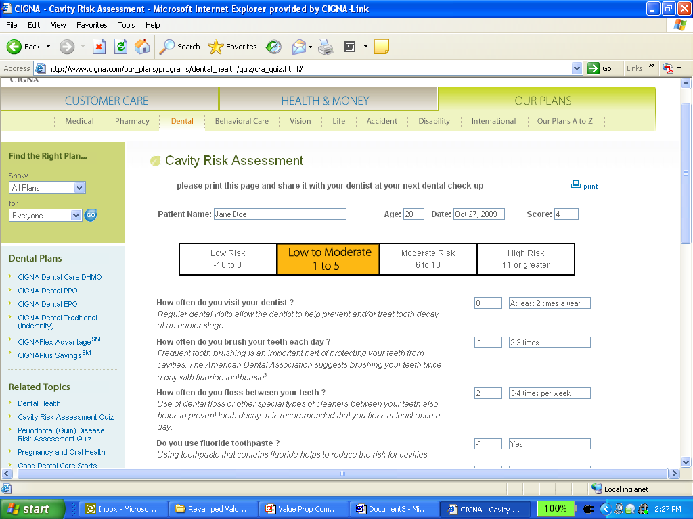
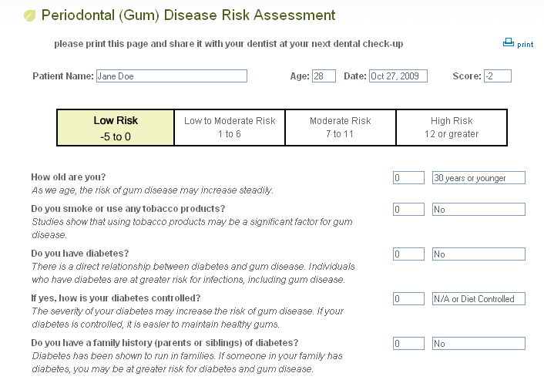
Online oral health assessments
Cavity Risk Assessment and Periodontal (Gum) Disease Risk Assessment
Cavities and gum disease are
preventable and treatable
Take these short quizzes to determine your risk for cavities or gum disease
Print your results and share them with your dentist
Available in English and Spanish
Available in the dental coverage section at myCigna.com
These tools are for informational purposes only. It is important to visit your dentist on a regular basis and discuss your oral health. Always consult with your doctor or dentist for appropriate examinations, treatment, testing and care recommendations.
Notes:
Tooth decay is one of the most common chronic infectious diseases among U.S. children.¹ The fact is, cavities touch all age groups². Older adults are more likely to have decay around older fillings, and decay of the tooth root itself.
Periodontal (gum) disease is an infection of the tissues surrounding and supporting the teeth, and it is a major cause of tooth loss in adults². Moreover, mounting research has linked gum disease to more serious health issues like heart disease, stroke, diabetes, and pre-term birth. Because gum disease is usually painless, however, you may not know you have it, and that’s where Cigna Dental comes in.
The Cavity and Periodontal Risk Assessment Tools help individuals determine their risks for cavities and gum disease, respectively. The tools are available online to members and the general public, alike, and function in a similar way.
Individuals complete a succinct quiz, and the tools provide a score indicating their risk for cavities or gum disease, depending on which tool the person has completed. Risk levels include: low, low to moderate, moderate or high risk. Members can then print the detailed score sheet and take it to their next dental visit. Armed with these results, patients and dentists can better manage their overall oral health.
¹Centers for Disease Control and Prevention
²American Academy of Periodontology Dispelling Myths about Gum Disease: The Truth Behind Healthy Teeth and Gums February 2010

Slide 15
HOW TO FIND A DENTIST
USING MYCIGNA.COM

Slide 16
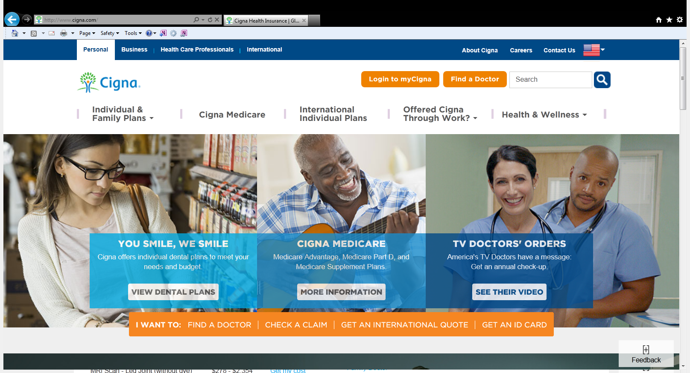
Go to www.Cigna.com and click on “Find a Doctor”

Slide 17
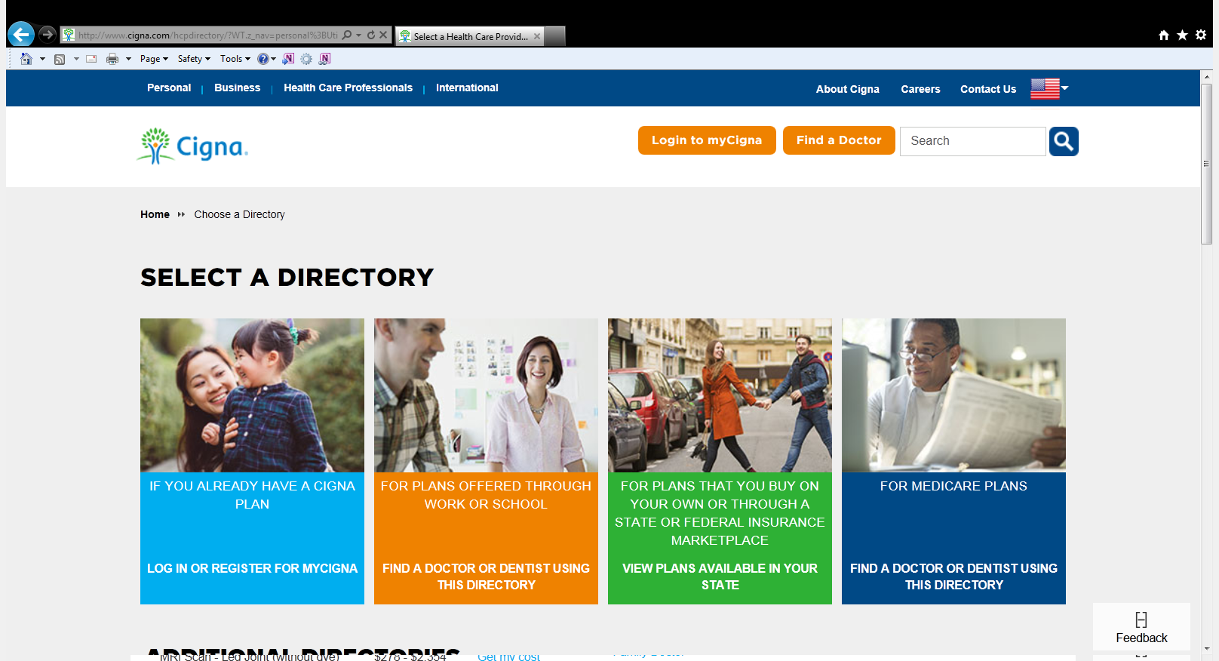
Click on the directory for plans offered through work or school (orange box)

Slide 18
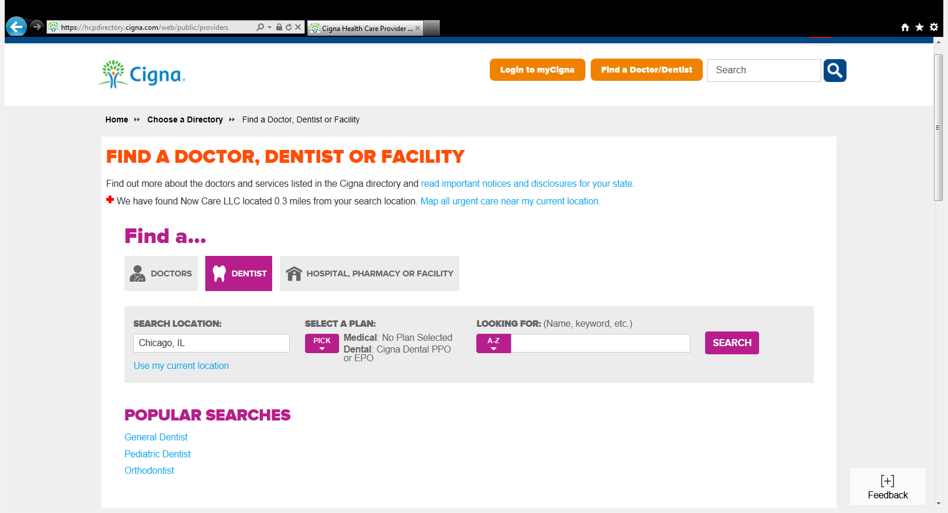
Click on “Dentist”
Under “Select A Plan” click on “Pick”
1
2

Slide 19
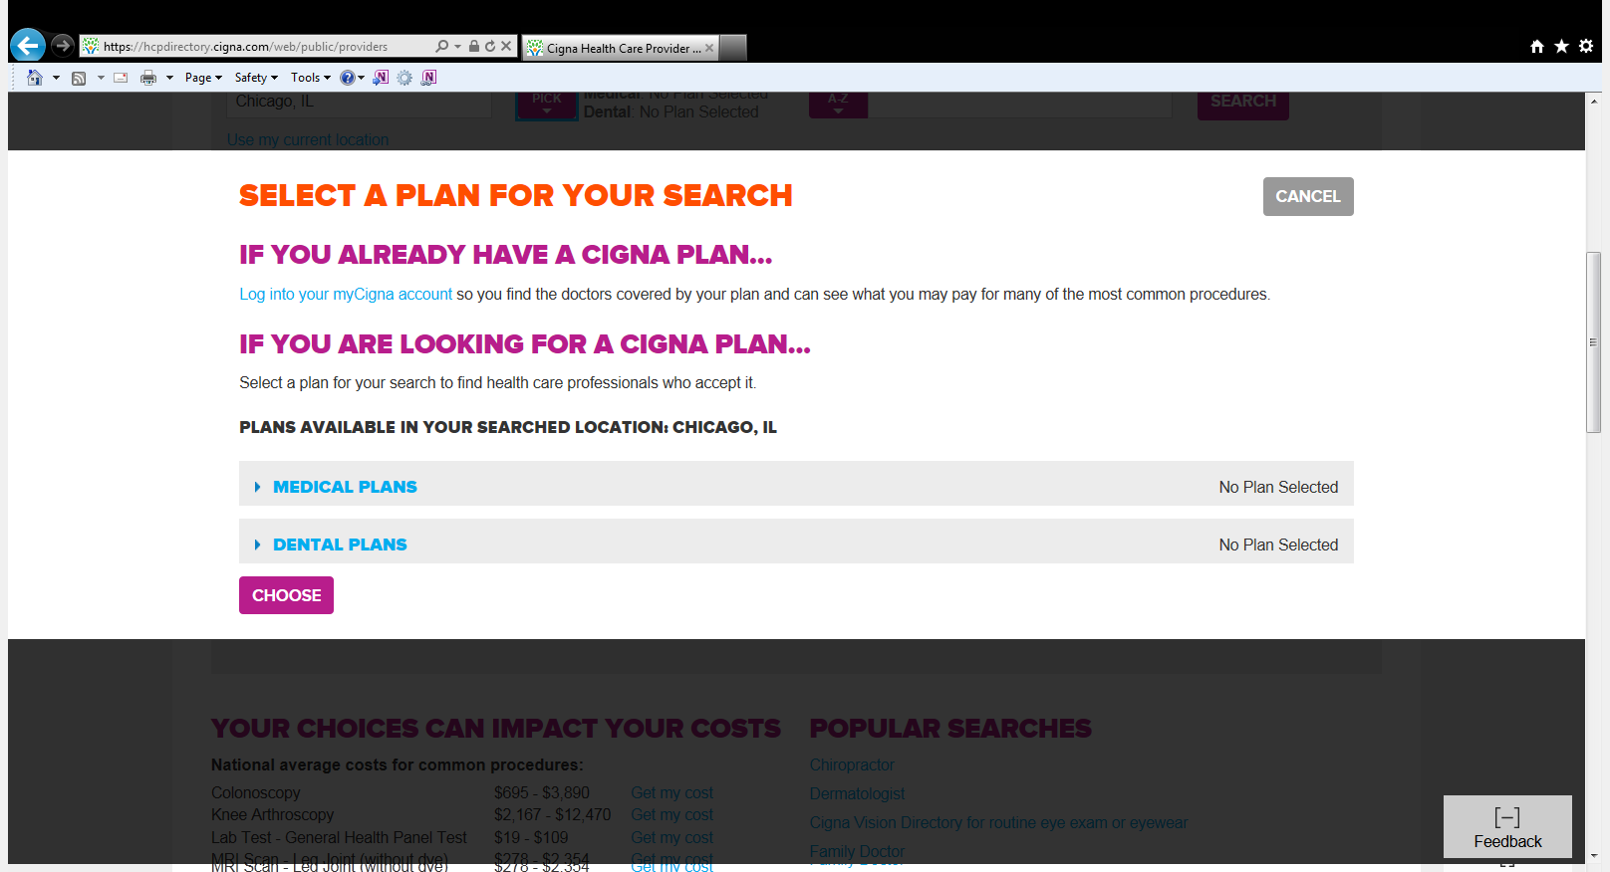
Click on “Dental Plans”
If you are looking for a DHMO Dentist please choose the 2nd option “Cigna Dental Care HMO.”
If you are looking for a DPPO Dentist please choose the 3rd option “Cigna Dental PPO or EPO”

Slide 20
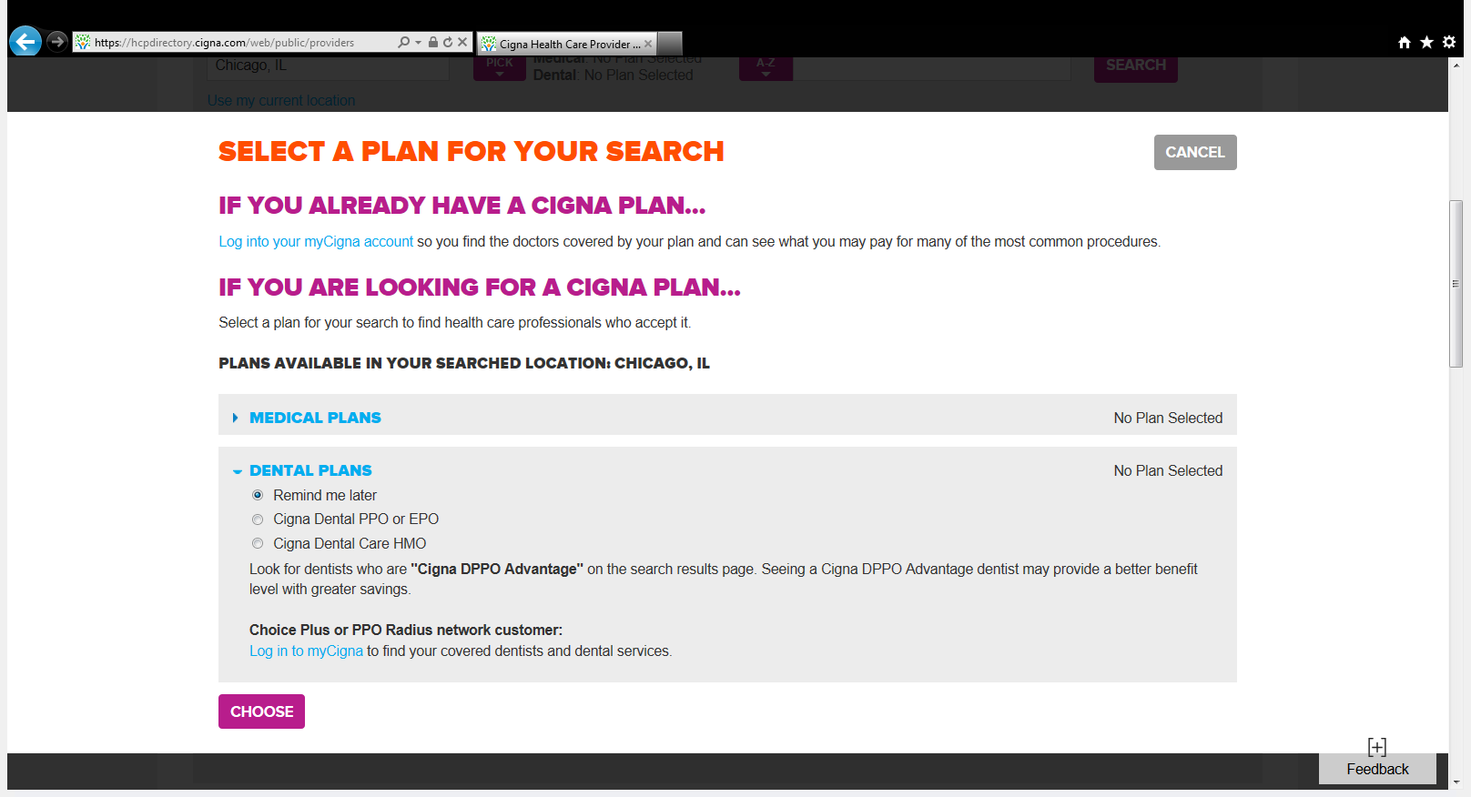
Select either Cigna Dental PPO or Cigna Dental Care HMO
Click on “Choose”
1
2

Slide 21
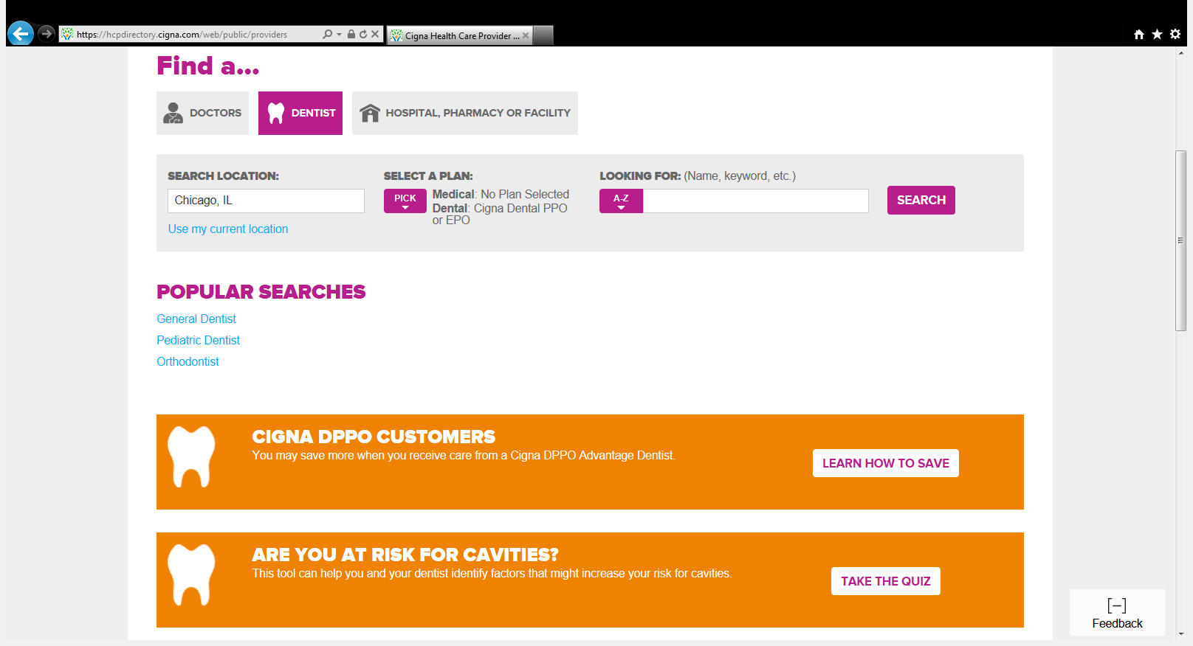
At this point, you may change the search location and enter what you’re looking for (type of dentist, the name of your dentist, etc.) and click on “Search”.

Slide 22
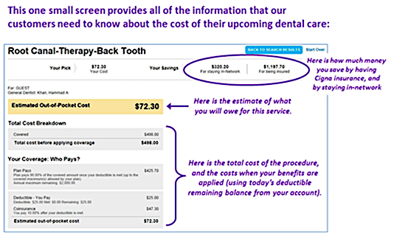
Estimate your dental care costs
Convenient, online access to estimate
dental care costs
Helps you to plan and budget
Specific to your plan information, average area charges for treatment bundles and individual dentist’s contracted fees for a single procedure
These examples are provided for illustrative purposes only. The Treatment Cost Estimator is for informational purposes and provides rough calculations only, based on the treatment or procedure you choose. It does NOT guarantee the exact amount of your out-of-pocket costs and it does NOT guarantee coverage for any treatment or procedure or any dental benefit plan payment. Your actual out-of-pocket cost for dental care will depend on the specific terms of your dental benefit plan.

Slide 23

Q&A
What you want to know

Slide 24
Dentists who participate in Cigna’s network are independent contractors solely responsible for the treatment provided and are not agents of Cigna. The information in this presentation summarizes the highlights of your plan. For a complete list of both covered and not covered services, including benefits required by your state, see your employer’s plan booklet, evidence of coverage, insurance certificate, or summary plan description – the official plan documents. If there are any differences between the information in this presentation and the plan documents, the information in the plan documents takes precedence.
All Cigna products and services are provided exclusively by or through operating subsidiaries of Cigna Corporation. Cigna Dental Care (DHMO) plans are insured by Cigna Dental Health Plan of Arizona, Inc., Cigna Dental Health of California, Inc., Cigna Dental Health of Colorado, Inc., Cigna Dental Health of Delaware, Inc., Cigna Dental Health of Florida, Inc., a Prepaid Limited Health Services Organization licensed under Chapter 636, Florida Statutes, Cigna Dental Health of Kansas, Inc. (KS & NB), Cigna Dental Health of Kentucky, Inc. (KY & IL), Cigna Dental Health of Maryland, Inc., Cigna Dental Health of Missouri, Inc., Cigna Dental Health of New Jersey, Inc., Cigna Dental Health of North Carolina, Inc., Cigna Dental Health of Ohio, Inc., Cigna Dental Health of Pennsylvania, Inc., Cigna Dental Health of Texas, Inc., and Cigna Dental Health of Virginia, Inc. In other states, Cigna Dental Care plans are insured by Cigna Health and Life Insurance Company (CHLIC), Connecticut General Life Insurance Company (CGLIC), or Cigna HealthCare of Connecticut, Inc., and administered by Cigna Dental Health, Inc. Cigna Dental PPO plans are insured or administered by CHLIC or CGLIC, with network management services provided by Cigna Dental Health, Inc. and certain of its subsidiaries. In Texas, the insured dental plan is known as Cigna Dental Choice, and this plan uses the national Cigna DPPO network. Policy forms: OK - Dental Indemnity/PPO: HP-POL99 (CHLIC), GM6000 ELI288 et al (CGLIC); DHMO: HP-POL115 (CHLIC), GM6000 DEN201V1 (CGLIC); TN – Dental Indemnity/PPO: HP-POL69/HC-CER2V1 et al, DHMO: HP-POL134/HC-CER17V1 et al (CHLIC). The Cigna name, logo, and other Cigna marks are owned by Cigna Intellectual Property, Inc.
862420 b 05/16 © 2016 Cigna. Some content provided under license.

Slide 25
Appendix A
DHMO for residents of Minnesota and Oklahoma
Minnesota Residents: When enrolling in a DHMO plan, you must visit your selected network dentist in order for the charges on the Patient Charge Schedule to apply. You may also visit other dentists that participate in our network or you may visit dentists outside the Cigna Dental Care network. If you do, the fees listed on the Patient Charge Schedule will not apply. You will be responsible for the dentist’s usual fee. We will pay 50% of the value of your network benefit for those services. You’ll pay less if you visit your selected Cigna Dental Care network dentist. Call Customer Service for more information.
Oklahoma Residents: DHMO for Oklahoma is an Employer Group Pre-Paid Dental Plan. You may also visit dentists outside the Cigna Dental Care network. If you do, the fees listed on the Patient Charge Schedule will not apply. You will be responsible for the dentist’s usual fee. We pay non-network dentists the same amount we’d pay network dentists for covered services. You’ll pay less if you visit a network dentist in the Cigna Dental Care network. Call Customer Service for more information.

Slide 26
Appendix B
DHMO Limitations and Exclusions
The following limitations apply to most DHMO plans: two (2) cleanings and bitewing x-rays per calendar year; one (1) full mouth/panorex x-ray every three calendar years; TMJ treatment (when included on your PCS) is limited to one (1) occlusal orthotic device every two years; the replacement of crowns and inlays, and prosthesis over implants (if unserviceable and cannot be repaired), is limited to once every 5 years. The frequency limitations of certain other covered services are set forth in the Patient Charge Schedule (PCS).
In general, only those services that are medically necessary and listed on the PCS are covered. The following services are generally not covered unless otherwise listed on the PCS or required by law:
experimental and cosmetic dentistry, and any services that do not meet common dental standards;
treatments or surgery if associated with a poor or hopeless diagnosis;
the recementation of any inlay, onlay, crown, post and core or fixed bridge, or implant supported prosthesis (including crowns, bridges, and dentures) within 180 days of initial placement;
crowns, bridges and implant supported prosthesis used solely for splinting;
completion of crowns, bridges, dentures, or root canal treatment already in progress on the effective date of your Cigna Dental coverage*; and
if your plan includes orthodontic coverage, the following is not generally not covered: (1) incremental costs associated with optional/elective materials; (2) procedures or appliances to guide minor tooth movement or correct harmful habits; (3) replacement of appliances that have been lost, stolen, or damaged due to patient abuse, misuse or neglect; or (4) any services which are not typically included in orthodontic treatment.
This is not a complete list and the terms of your specific dental plan may vary. See your plan documents for a complete list of plan terms, conditions, exclusions and limitations.
*California and Texas residents: Treatment for conditions already in progress on the effective date of your coverage are not excluded if otherwise covered on the PCS.

Slide 27
Appendix C
DPPO Limitations and Exclusions
The following limitations apply to most DPPO plans: two (2) cleanings per calendar year, one (1) bitewing x-ray per calendar year, one (1) full mouth x-ray every five calendar years, and one (1) panorex x-ray every five calendar years; crowns and inlays replacement of crowns and inlays is limited to once every 5 years; prosthesis over implants is limited to one (1) every 5 years if unserviceable and cannot be repaired; replacement of bridges is limited to once every 5 years; replacement of dentures and partials is limited to once every 7 years; coverage for sealants is limited to posterior tooth, with one (1) treatment per tooth every three years up to a maximum age of 16; space maintainers are limited to non-orthodontic treatment.
The following are generally not covered unless included in your specific dental plan or required by law:
  services that are not medically necessary;
  experimental dentistry, cosmetic dentistry, or any services that do not meet common dental standards;
  replacement of a bridge or denture which can be made useable according to accepted dental standards;
  procedures, appliances or restorations, other than full dentures, whose main purpose is to change vertical dimension, diagnose or treat conditions of TMJ, stabilize periodontally involved teeth, or restore occlusion;
  veneers of porcelain or acrylic materials on crowns or pontics on or replacing the upper and lower first, second and third molars;
  bite registrations; precision or semi-precision attachments; splinting;
  surgical implant of any type; and
  charges for unnecessary care, treatment or surgery, or charges in excess of the reasonable and customary allowances.
  Depending on your plan, the replacement of teeth that are missing prior to your effective date of coverage may not be covered. This is not a complete list and the terms of your specific dental plan may vary. Waiting periods may apply. See your plan documents for a complete list of plan terms, conditions, exclusions and limitations.

